Slide 1
TCP 2.0

Slide 2
Box inside a box
IP
Sender/Receiver IP
TCP
Sender/Receiver Port
HTTP/1.0 200 OK
Host: google.com
…
<head>
…

Slide 3
What does TLS (Transport Layer Security) Secure?
IP
TCP
HTTP/1.0 200 OK
…
<head>
…
Only secures the data section of the TCP protocol.

Slide 4
TCP – Process and Networking
Sender
Process
Receiver
Process
Sender TCP
Receiver TCP
Unread
Empty
Sent, UnAck
Empty
Unsent

Slide 5
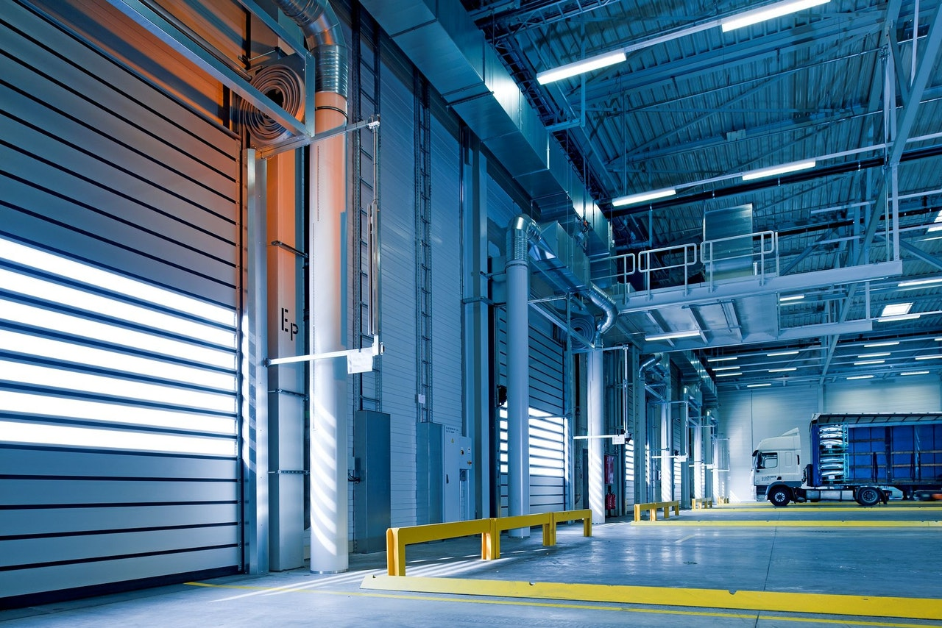

Slide 6
TCP Header
Rwnd
- Tells the sender how fast or slow to go.

Slide 7
What about lost packets (segments)
Two strategies
Timeout
If a packet hasn’t been ACK’d within a certain amount of time, resend
X repeated ACK
If we get 3 repeated ACK < a sent Segment #, resend that segment
Sender sends 1,2,3,4,5,6,7. Segment 2 gets lost.
Receiver gets 1,3,4,5,6,7
Receiver ACK’d 1,1,1,1,1,1 (ACK segment+1, so these ACK 2)

